Slide 1
Parabolic Antenna
at 7Ghz

Slide 2
Team Member
2
Nawaz Talukdar Sanglap
1709016
Md Rabiul Hasan
1709017
Avizit Nandi Avin
1709018

Slide 3

Introduction:
A type of reflector which has a reflecting surface having the shape of a paraboloid that is used to collect and re-radiated the electromagnetic energy is known as Parabolic Reflector. It is regarded as the simplest and popular form of reflector antenna.

Slide 4
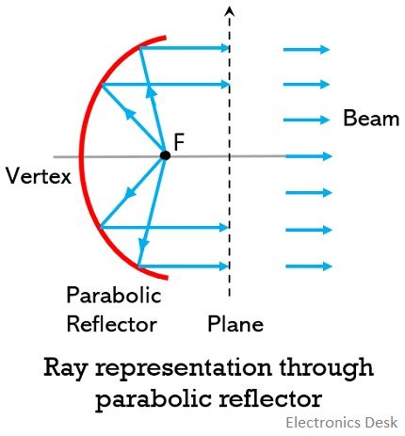
Working Principle of Parabolic Reflector:
Consider having a parabolic reflector in receiving mode and where the feed element is present at the focus. The crucial function of the parabolic reflector is to change the spherical wave into a plane wave. So, at the focus when a feed antenna is placed which is nothing but an isotropic source then the waves are emitted from the source. The radiating element used at the focus is generally horn antenna , which are used to illuminate the reflecting surface. Thus, the waves emitted from the source, incident on the surface of the reflector and are further reflected back as a plane wave of circular cross-section.

Slide 5
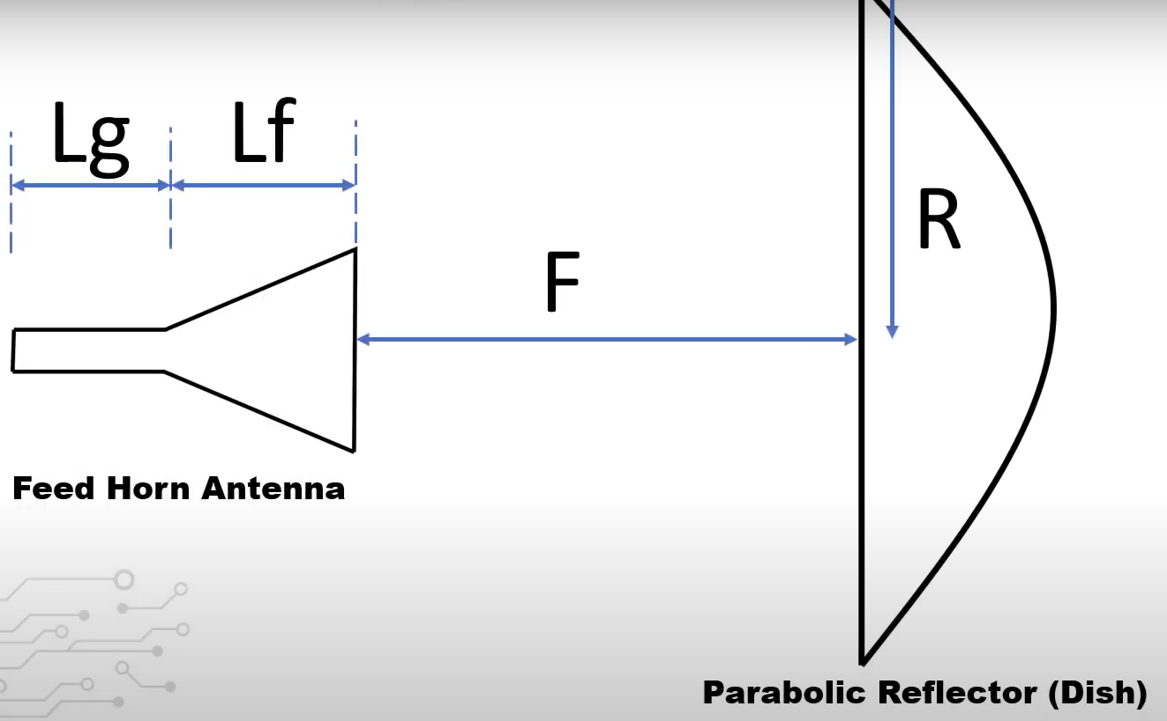
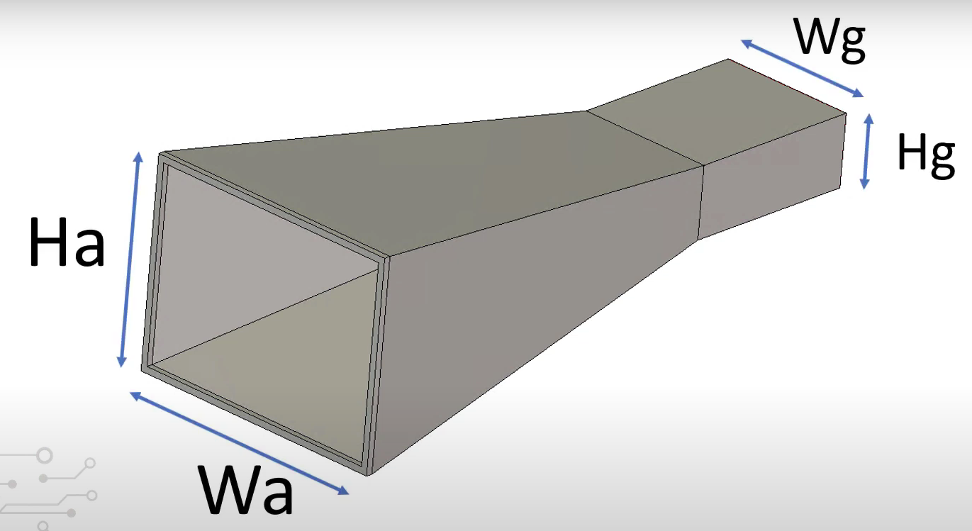
In this third project assignment, we are required to design a parabola reflector antenna using Computer Simulation Technology (CST) Studio Suite. CST has number of solvers in it both frequency and time domain. However in this project only transient solver is used which is time domain solver. CST is based on finite domain time difference method (FDTD). The antenna is front-fed by a circular horn waveguide antenna with rectangular waveguide feed of a given standard S as prescribed in the table below. The antenna is working at 6.8Ghz.
Table 1:Parameters list
Name | Value(mm)
A | 0.005
R | 110
Rt | 8
F | 160
Lf | 42
Lg | 19
Wg | 16
Hg | 11
Wa | 27
Ha | 21
Mt | 0.9
Rs | 0.5
Fig 1: Horn Antenna

Slide 6
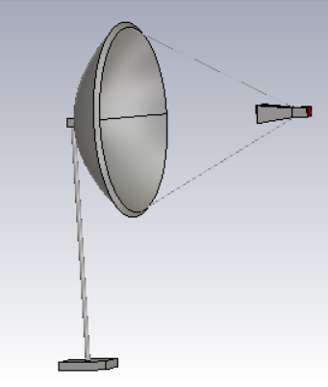
The simulation takes up about 8 hours to complete with default mesh properties. Such long period is taken because the CST uses time domain transient solver instead of frequency domain solver in other software for example High Frequency Structure Simulator (HFSS) that based on finite element method (FEM).
Fig 2: Parabolic reflector antenna

Slide 7
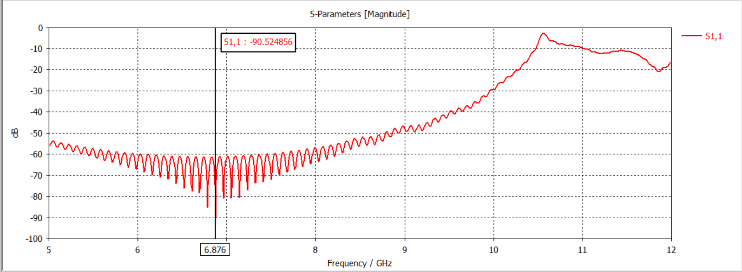
Results:
Figure 3: S-parameter S1,1 magnitude vs. frequency
Figure 3 shows S-parameter 1D plot marked at frequency of 6.876 GHz as the nearest frequency to the operating frequency of this antenna which is 7 GHz. Generally, the preferred value is in the range of -10 to -20 dB. However, the value less than -10 dB proved that the antenna is transferring the maximum power and thus almost no power is reflected back. Further adjustments can be made to achieve its desired performance by varying the distance of the horn antenna to the reflector, a, size of the antenna, and others.

Slide 8
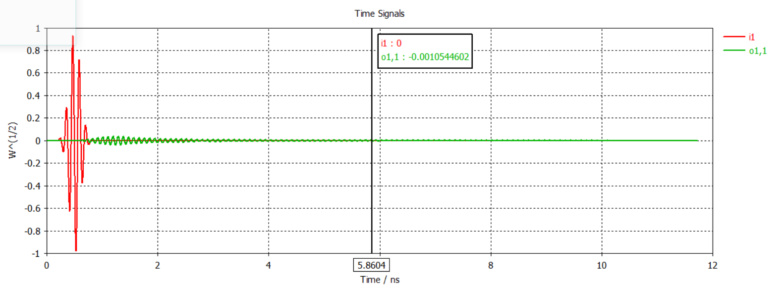
Figure 4: Port signal plot.

Slide 9
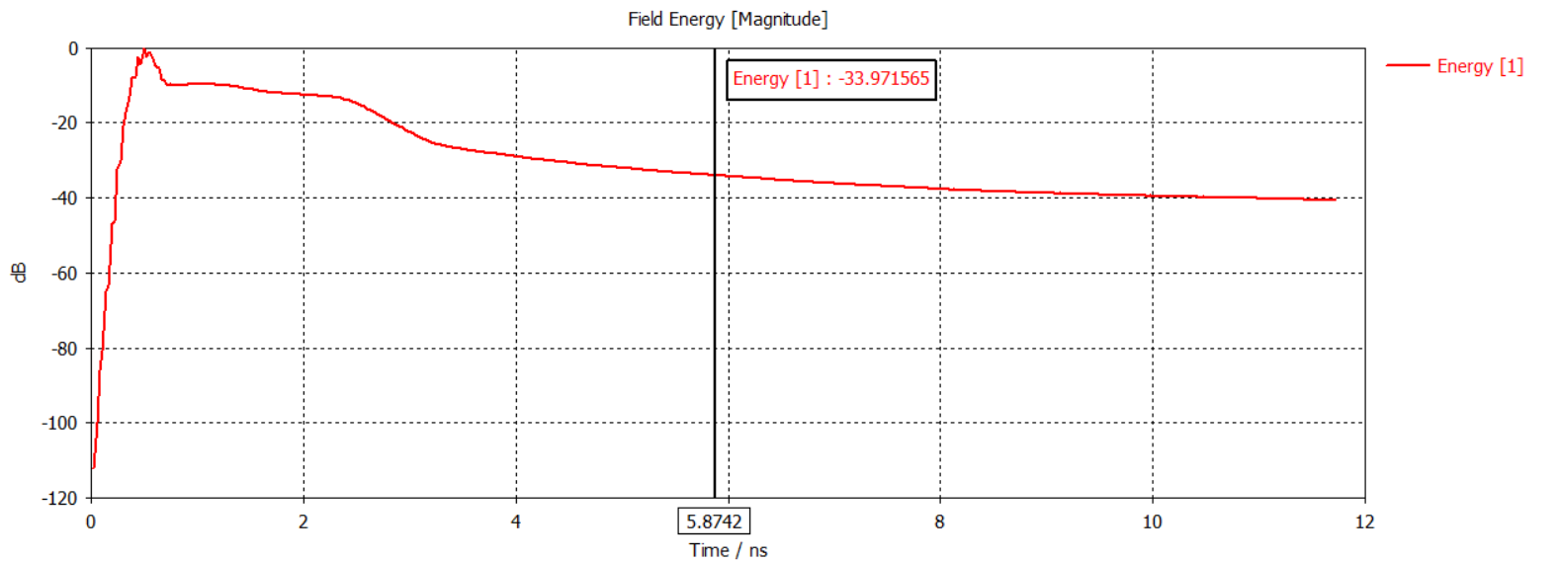
Figure 5: Energy plot.

Slide 10
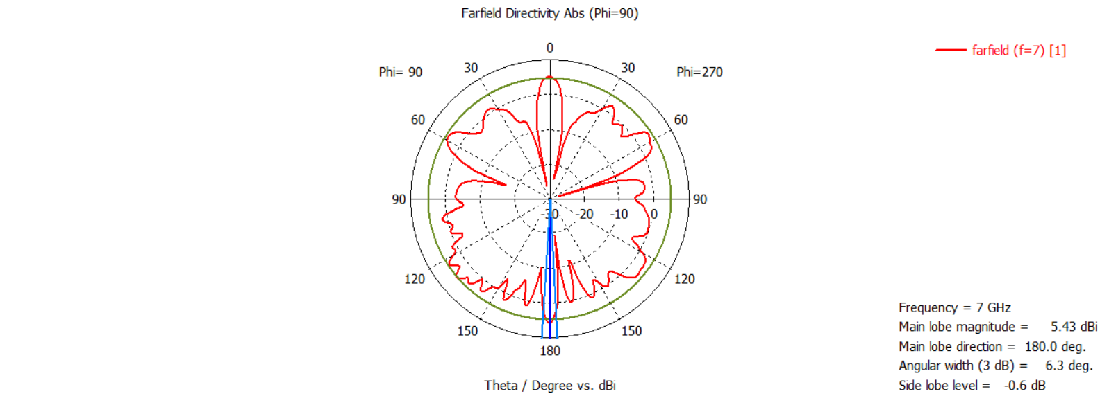
Figure 6: Far field radiation pattern in polar form.
The Far field radiation pattern in polar form indicates that the main lobe which resembles correct signal radiation is bigger than the side lobe level. It indicates a good sign of directivity.

Slide 11
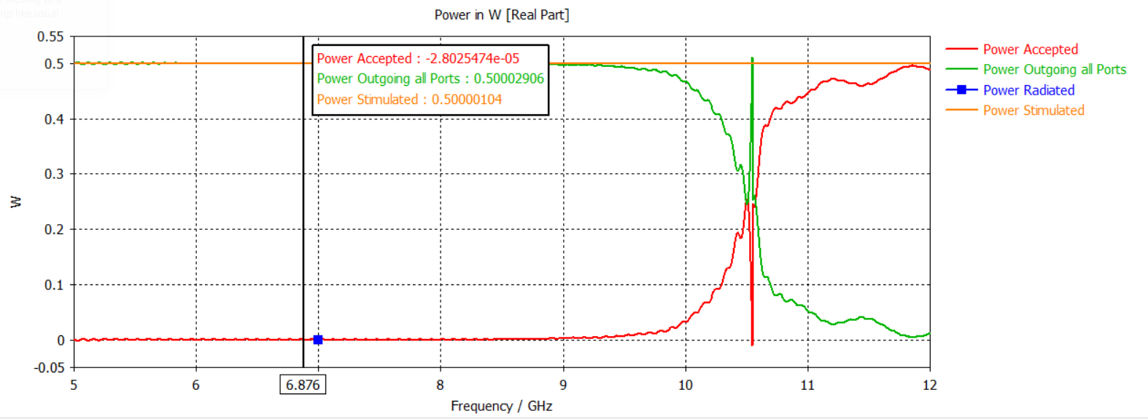
Figure 7: Power accepted and outgoing plot.
Power accepted and outgoing plot shows that the antenna power is radiating at 6.876GHz which is desired frequency for our antenna design.

Slide 12
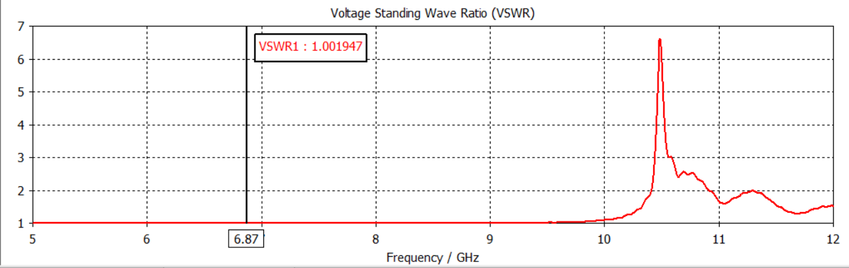
Fig 8: VSWR curve
For an antenna operation the VSWR(Voltage Standing Wave Ratio) should be in between 1 and 2 .In our antenna design the VSWR is 1.001947 and it shows that our antenna is working properly.

Slide 13
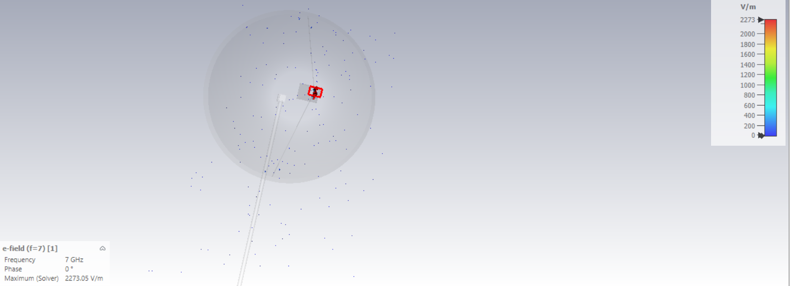
Figure 9: E field of the antenna.

Slide 14

Figure 10: H field of the antenna.

Slide 15
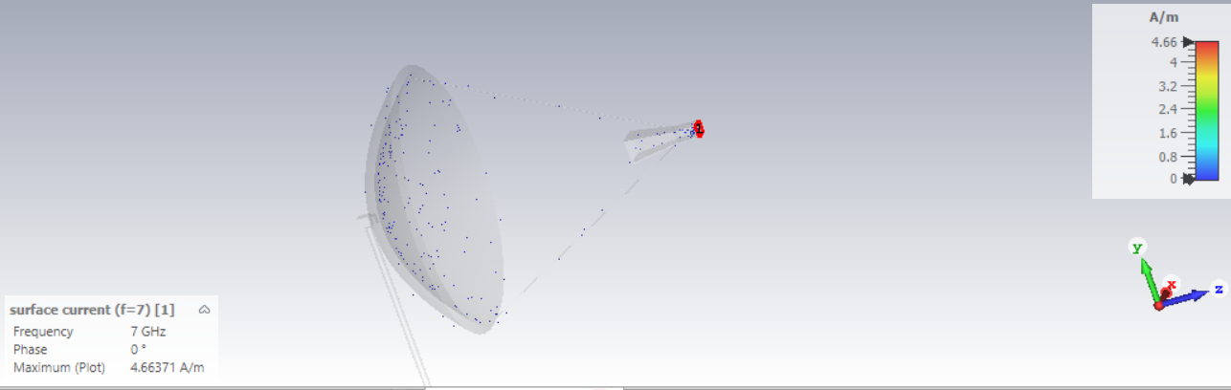
Figure 11: Surface current of the antenna.

Slide 16
CONCLUSION:
The design of a conical horn antenna fed by rectangular waveguide with parabolic reflector is very easy to be design using CST. However, the time domain transient solver used by the software cause the simulation to take so much time to complete the simulation. It took almost 8 hours to complete. The antenna is working at the given frequency of 6.8 GHz with necessary dimensions. The analysis of the overall results of the antenna suggests that the antenna has achieves its desired performance in terms of directivity and gain . The radiation fields obtained was quite narrow beam that also resembled a characteristic of a horn antenna with parabolic reflector. In addition, polar plot formed shows that the antenna has small side lobes compared to its main lobe. This is a desired performance since the outgoing waves from the horn successfully propagate in the behavior of TEM waves toward the reflector.

